Slide 1
Computer Architecture
Lab (1)
Introduction

Slide 2

Congratulations

Slide 3
Lab Marks
Total 100 marks & separate grade
15 lab best of 12 labs will be selected.
Each lab contain 5marks. Total 60marks
Lab Assignment 2 each 10 marks
Final Lab=20 marks

Slide 4
Important Points
Only 6 absents are allowed
Join Google classroom
On Google classroom whatsAPP group link is shared join it.
Submit LAB task on time.
Late submission will be accepted with some penalty. (upto certain time)

Slide 5
Submission of LAB
You have to submit two files in labs
One file of word or note pad of code and answers
Recording video of lab task simulation
Submit on Google classroom.
On LMS submit only wordfile.

Slide 6
To pass the lab you have to meet certain criteria.
Please don’t beg for numbers. Earn it
You guys are not beggars.
You are warriors so earn the numbers.
Don’t get dishearten if you couldn’t make it this time try again next semester .

Slide 7


Slide 8
Different Architectures.
Instructions sets.
Techniques to enhance the performance.
Memory Units (RAM, Cache, Hard Drive)
Instruction Cycle
Interrupts

Slide 9
Outcome of the lab
To identify different types of development boards.
Able to program Arduino.
How to integrate hardware with your software.
IoT, Robotics.

Slide 10
CA is Important for
IoT
Embedded systems
Robotics
OS & Firmware developers
Game developers

Slide 11
Revise These Topics
Mux, Dmux
Encoder and decoder
Flipflops, latches
Counters and registers
Assembly language (done in Coal)

Slide 12
Digital IC
Application-specific integrated circuit
Field-programmable gate array (FPGA)
Graphics processing unit(GPU)
Digital signal processor
Microcontrollers
Microprocessors

Slide 13
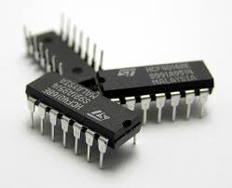
Digital IC
Simple IC’s like (AND NOT, OR)gates
Counters
Decoders
MUX
DMUX
FlipFlops

Slide 14
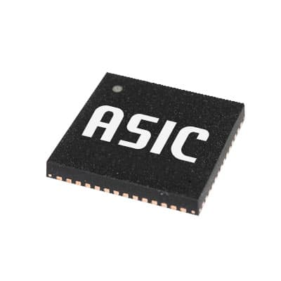
Application-specific integrated circuit
An application-specific integrated circuit is an integrated circuit chip customized for a particular use, rather than intended for general-purpose use. For example, a chip designed to run in a digital voice recorder or a high-efficiency bitcoin miner is an ASIC

Slide 15
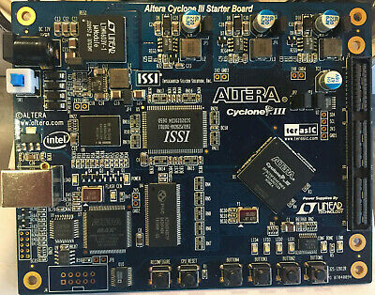
FPGA
A field-programmable gate array is an integrated circuit designed to be configured by a customer or a designer after manufacturing – hence the term "field-programmable"

Slide 16
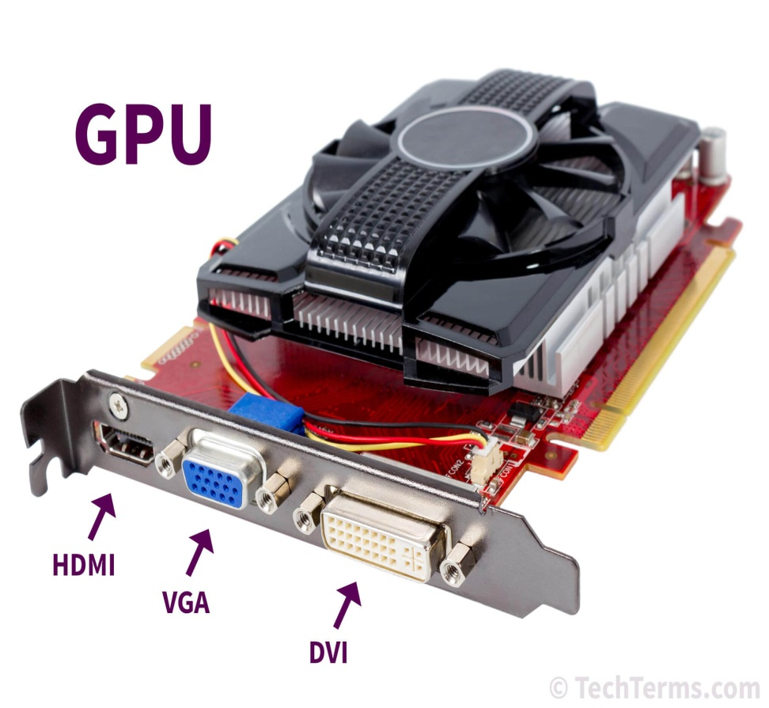
GPU
A graphics processing unit is a specialized electronic circuit designed to rapidly manipulate and alter memory to accelerate the creation of images in a frame buffer intended for output to a display device

Slide 17
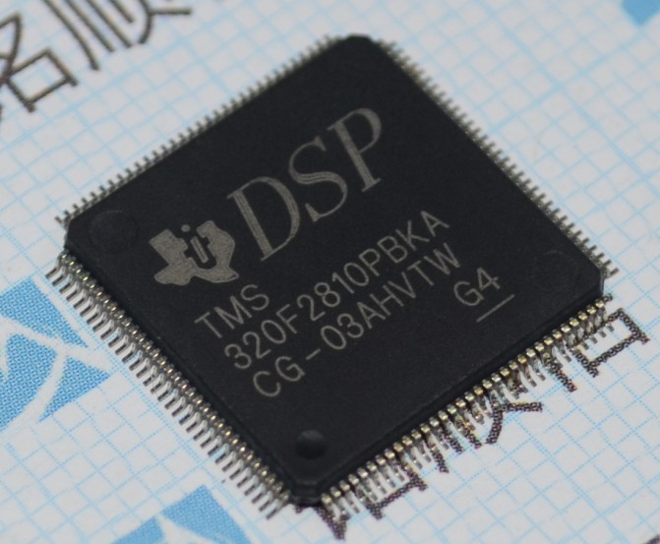
DSP
A digital signal processor is a specialized microprocessor chip, with its architecture optimized for the operational needs of digital signal processing.

Slide 18
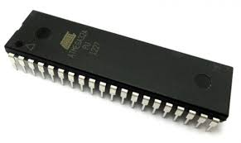
Microcontroller
A microcontroller is a small computer on a single metal-oxide-semiconductor integrated circuit chip. In modern terminology, it is similar to, but less sophisticated than, a system on a chip

Slide 19
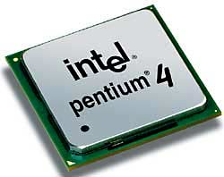
Microprocessor
A microprocessor is a computer processor that incorporates the functions of a central processing unit on a single integrated circuit

Slide 20
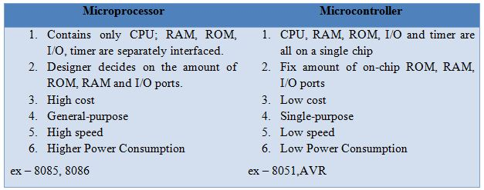

Slide 21
Developments Boards
A development board is a printed circuit board with circuitry and hardware designed to facilitate experimentation with a certain microcontroller.

Slide 22
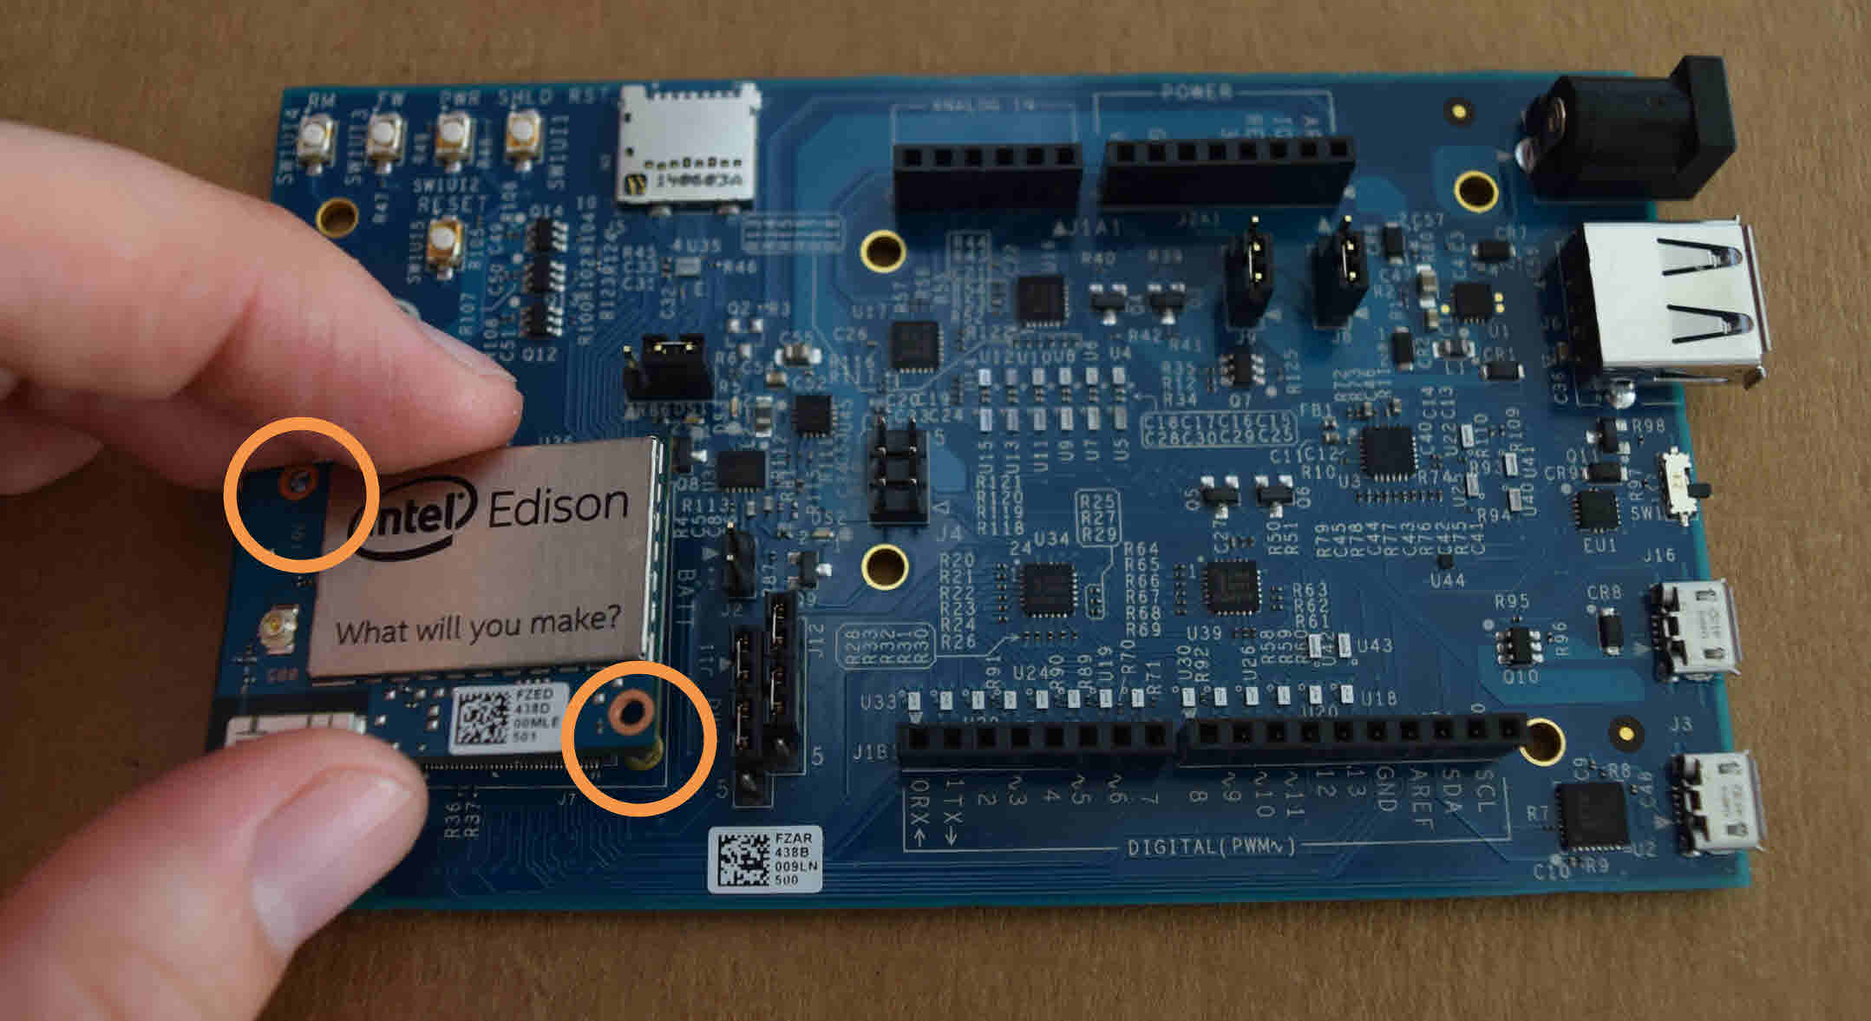
Intel Edison

Slide 23
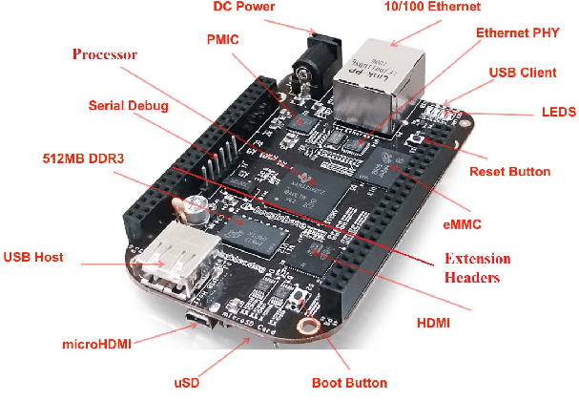
Beagle Board

Slide 24
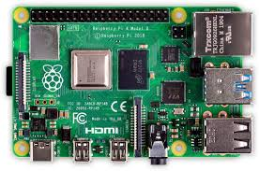
Raspberry Pi

Slide 25
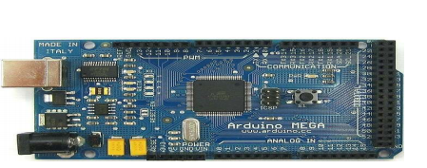
Arduino

Slide 26
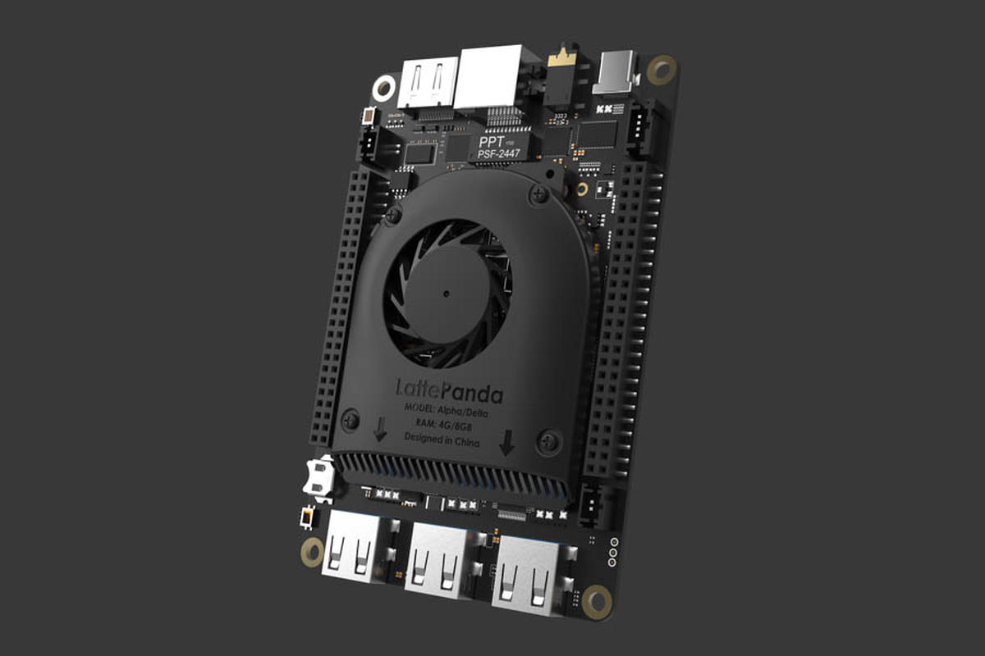
LattePanda

